Slide 1
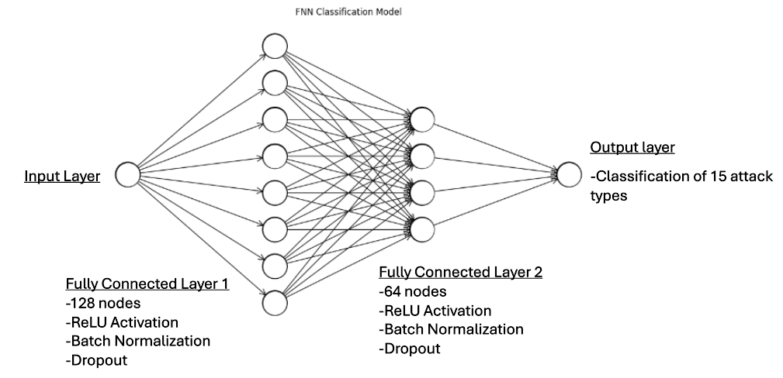
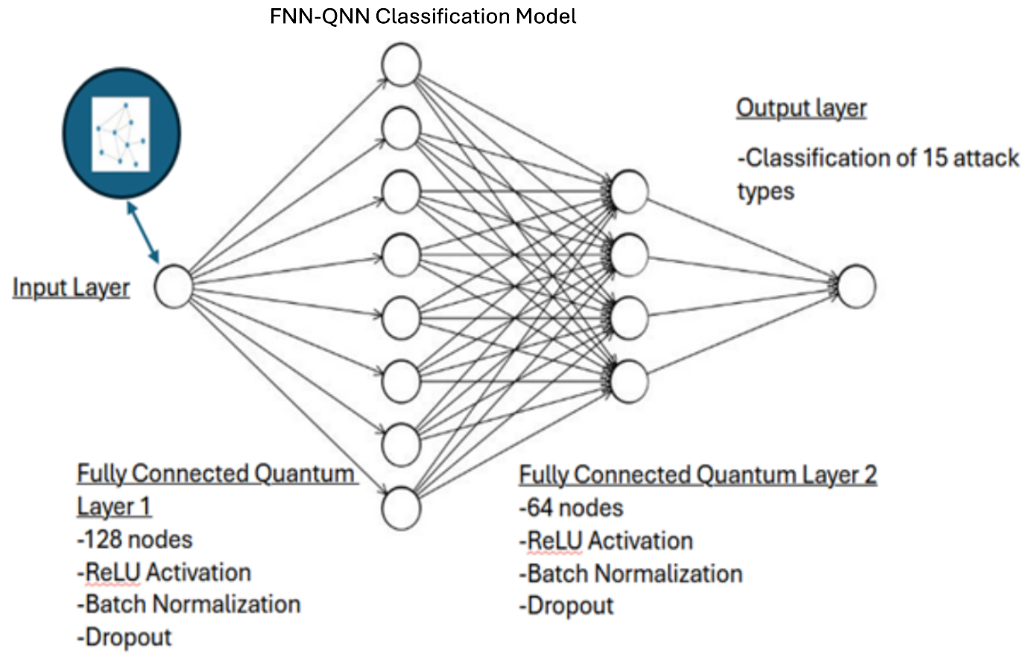
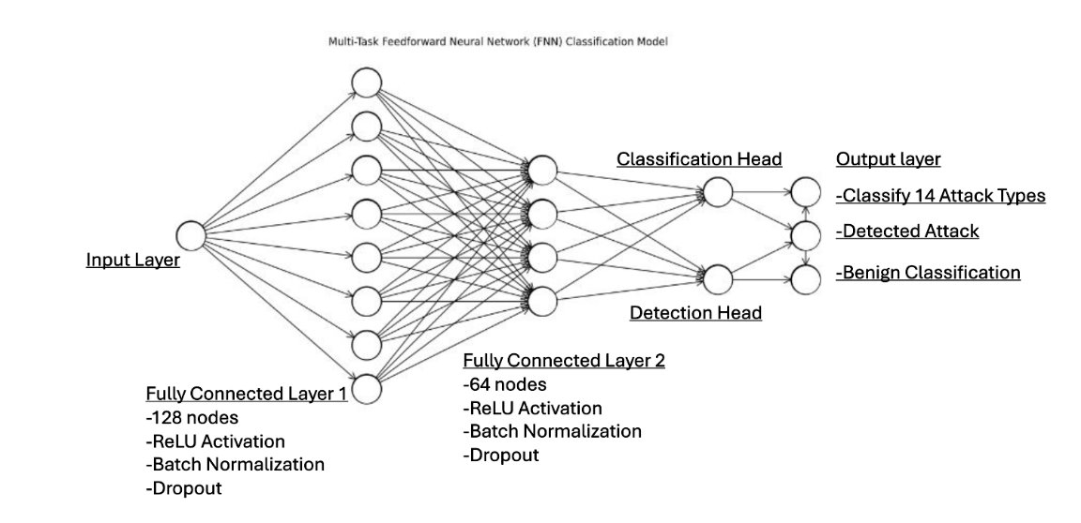
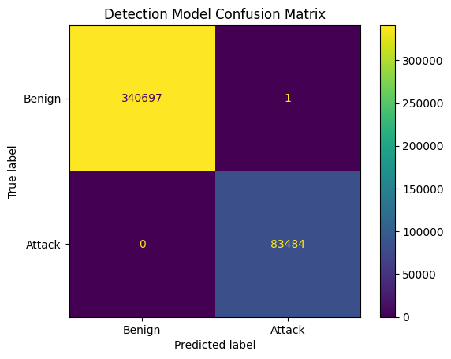
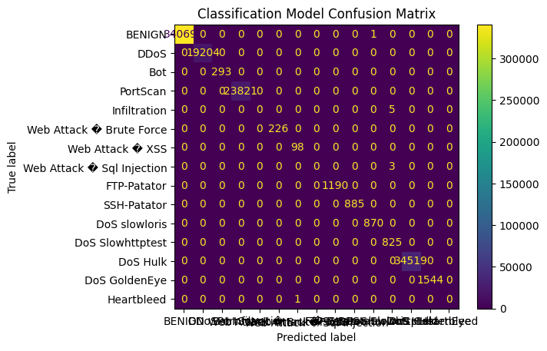
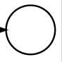
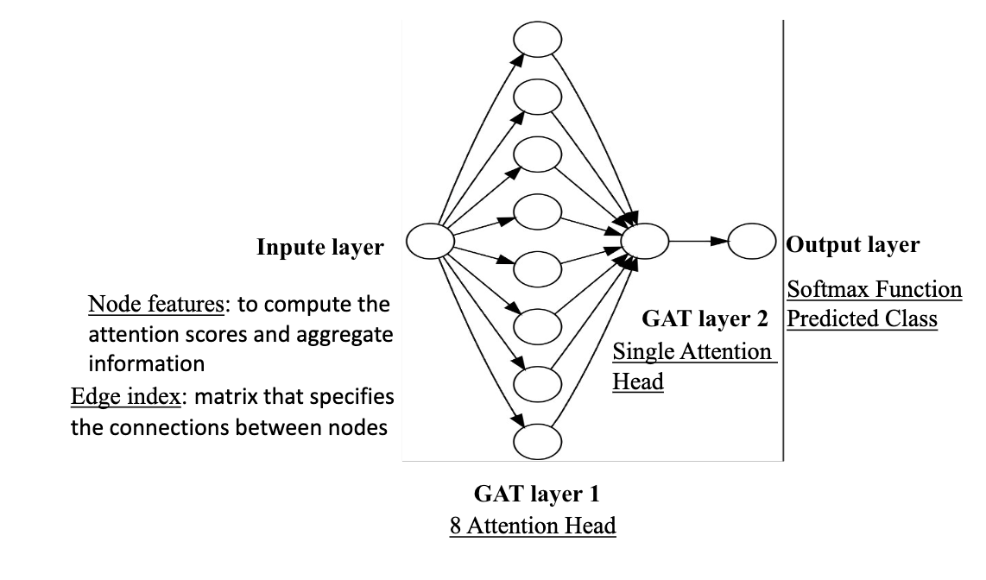

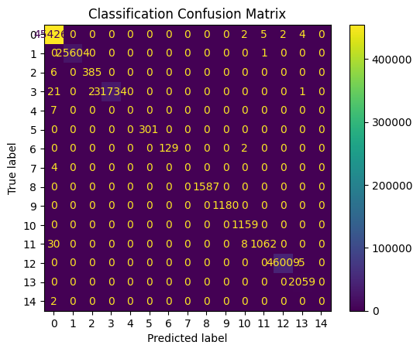
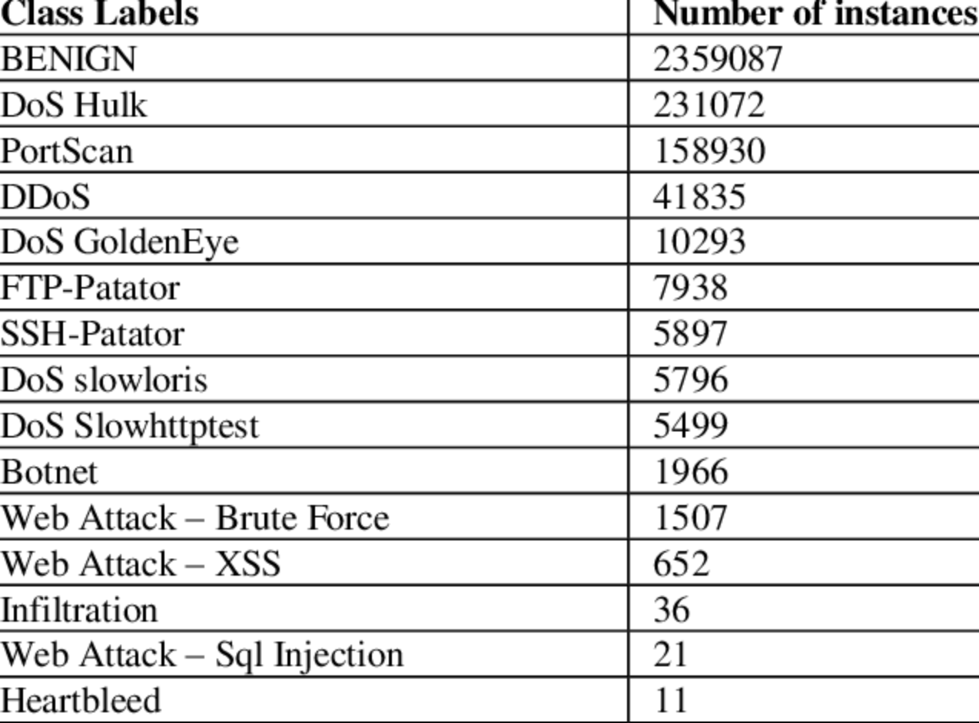
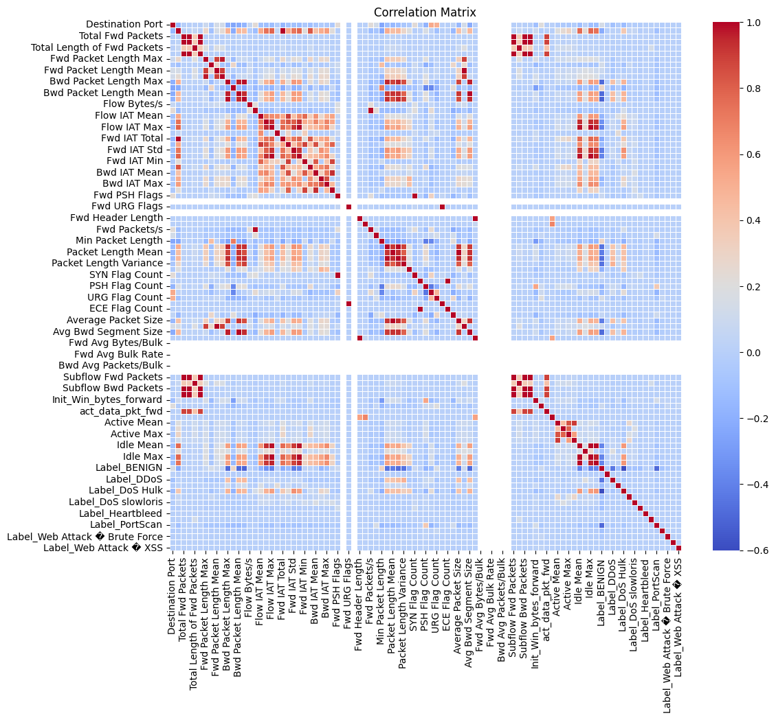
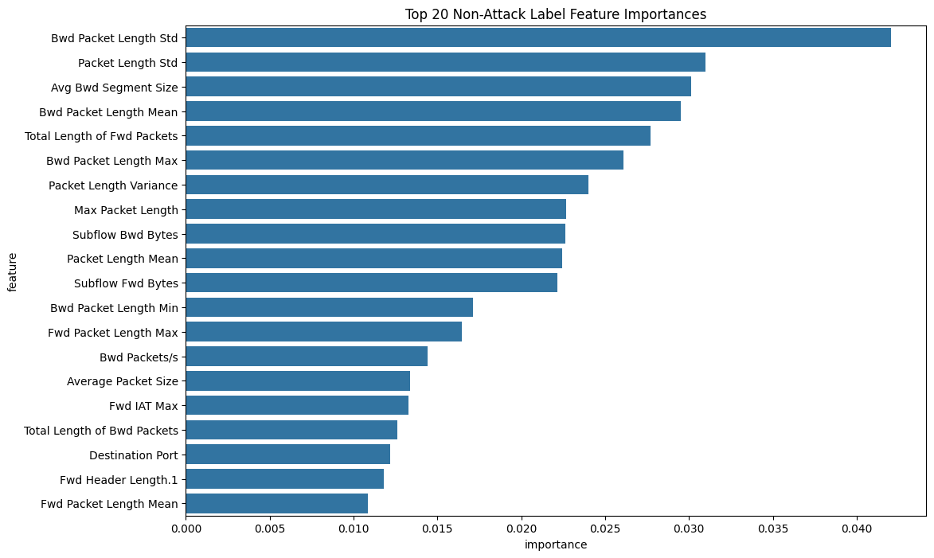

Intrusion Detection using Quantum Enhanced Graph Attention Networks and Feed-Forward Neural Networks
Selam Mitike (University of California, Santa Cruz )
Tom Steinman (University of Missouri-Kansas City)
NSF REU AI-Empowered Cybersecurity
Advisor: Professor Yugyung Lee (Leeyu@umkc.edu)
Introduction
Models
Results
Discussion
Problem: Traditional Intrusion Detection Systems (IDS) struggle to accurately detect and classify sophisticated cyberattacks in dynamic environments like smart homes, IoT, and enterprise networks.
Need: There’s a growing need for models that can not only detect anomalies but also classify attack types, track intrusion paths, and adapt to evolving threats — ideally in real time.
Quantum AI Approach: Quantum Neural Networks (QNNs) offer a novel path forward. By leveraging quantum-inspired features such as superposition and entanglement, QNNs can capture complex patterns in high-dimensional data that classical models might miss.
Models Used:
Graph Attention Networks (GAT): A type of Graph Neural Network that uses attention mechanisms to focus on the most relevant nodes, enhancing anomaly detection in network traffic graphs.
Feedforward Neural Network (FNN): A baseline model where data flows linearly through input, hidden, and output layers.
QNN Hybrid: Integrates quantum-inspired layers within a classical model structure, aiming to improve classification performance and generalization under limited or noisy data.
Multi-Classification Model Results
This study demonstrates strong classification performance across all models, with the Multi-Classification FNN achieving low variance, minimal loss, and exceptional generalization—without requiring quantum enhancements. While sinusoidal quantum-inspired layers improved most models, they showed limited value in the Multi-Task FNN, suggesting quantum benefits may be architecture-specific. Certain attacks (e.g., Infiltration, SQL Injection) remained undetected, reflecting CICIDS2017 limitations such as class imbalance and low sample diversity. The dual-task training and K-fold cross-validation proved effective for robustness and evaluation. Additionally, the FNN's simple design enables fast, efficient, single-pass classification and detection, making it well-suited for edge or real-time deployment. These results validate classical architectures for intrusion detection while offering early insight into how quantum-inspired features could evolve within emerging Quantum AI research.
This work provides a practical baseline for future hybrid approaches, where classical efficiency meets quantum-inspired innovation in scalable, intelligent network defense systems. This work bridges classical efficiency with quantum inspiration, making a step toward a more adaptive and intelligent cybersecurity solution in the quantum era.
CIC-IDS 2017 Classification
Classification Models | Accuracy | Precision | F1 Score | ROC AUC
FNN | 96.01% | 96.02% | 95.49% | 99.49%
FNN-QNN | 98.42% | 98.39% | 98.38% | 99.86%
Multi-Task FNN | 99.99+% | 99.99+% | 99.99+% | 99.99+%
Multi-Task FNN-QNN | 99.98% | 99.98% | 99.98% | 99.98%
Multi-Task FNN Classification Model:
Conclusion
Objective
This research provides evidence of the potential benefits of quantum-inspired activations in intrusion detection. The results underscore the promise of hybrid and classical neural models in cybersecurity, especially when paired with efficient training strategies and evaluation frameworks.
By leveraging quantum parallelism, entanglement, and superposition, quantum computing offers unique advantages in optimization, pattern discovery, and the processing of complex, high-dimensional data challenges that often limit classical systems in real-time and adaptive threat environments, particularly those underrepresented in current benchmark datasets.
As quantum computing becomes more accessible, these findings lay the groundwork for future AI-powered security tools and encourage deeper exploration into fully quantum neural architectures for next-generation threat detection.
Main Goal: Evaluate and compare performance of classical and quantum enhanced neural networks for intrusion detection and classification using Feedforward Neural Networks (FNN) and Graph Attention Networks (GAT) on binary and multi-class intrusion detection.
Compare the performance of Feedforward Neural Networks (FNN) and Graph Attention Networks (GAT) on binary and multi-class intrusion detection tasks, with and without quantum layers.
Integrate quantum-inspired layers into FNN and GAT architectures to create FNN-QNN and GAT-QNN models.
Evaluate model effectiveness using benchmark datasets (Smart Home NID & CICIDS2017) in terms of accuracy, robustness, and scalability.
Identify the advantages and limitations of GNNs vs. FNNs in handling structured tabular data vs. graph-based data, and how it is affected by quantum layers.
Explore model explainability by analyzing key features and patterns relevant to different types of network intrusions. Determine suitability in future adaptations.
Quantum layer
Linear Transform: y=Wx+b, where W is a weight matrix and b is a bias vector.
Sigmoid Activation: σ(x)=1/1+e^{-x} to the output of the linear transformation
Detection Matrix Key
TN | FP
FN | TP
Future Works
Multi-Task FNN-QNN Classification:
Explore Advanced Quantum Architectures: Expand beyond sinusoidal activation by testing variational quantum circuits and hybrid quantum-classical networks. Evaluate performance on quantum simulators and real quantum hardware using frameworks like IBM Qiskit or Xanadu PennyLane. Implementing a full Quantum Neural Network (QNN) for comparison.
Benchmark on Diverse Datasets: Validate model generalizability by testing on additional datasets such as UNSW-NB15 and CICIDS2018, which include a broader range of modern attack types.
Detection of Zero-Day and Rare Attacks: Incorporate anomaly detection, semi-supervised learning, or GAN-based augmentation to enhance sensitivity to unseen threats like zero-day attacks and underrepresented classes (e.g., SQL Injection, Infiltration, Heartbleed).
Deploy for Real-Time Network Monitoring: Implement optimized models in a live home or enterprise network environment to assess latency, efficiency, and robustness in real-time intrusion detection.
Integrate with Language Models for Explainability: Combine classification models with Small or Large Language Models (SLM/LLM) in a Mixture of Experts (MoE) framework to enhance interpretability. This would allow:
Real-time alerts with natural language explanations
Visualizations of intrusion paths
Identification of impacted devices across the network
Hybrid Quantum AI Systems: Investigate systems that combine classical deep learning layers for preprocessing with quantum layers for high-dimensional feature transformations, balancing performance with resource efficiency.
Results
Methodology
Binary Detection Models
Data Collection & Preprocessing
Collected and analyzed two benchmark datasets: CICIDS2017(2.83 million samples, 79 features, 15 classes) and Smart Home Intrusion Detection (148,517 samples, 23 features, binary classification).
Cleaned missing values, handled outliers, normalized features, and applied one-hot encoding to categorical variables.
Model Construction
Identified modern models to be used for detection.
Modified models for use in classification
Built FNN and GAT Models.
Designed multi-task versions and quantum-enhanced variations (FNN-QNN, GAT- QNN).
Feature Extraction
Performed dataset analysis and feature importance.
Created a correlation matrix, determined top features to provide explainability in the dataset.
Used Random Forest to determine top features in classification and features to drop.
Model Training
Trained models using various ranges of epochs to avoid overfitting and underfitting.
Tested the models to compare metrics (80/20 Training to Test splits).
Used ReLU activations, dropout layers, Adam optimizer with L2 regularization (updates weights during training).
Integrated quantum layers with sine activation to simulate quantum behavior.
Verify the results: K-fold cross validation, feature scaling, dropout, no data leakage, overfitting, underfitting.
Evaluation
Evaluated models using accuracy, precision, recall, F1 score, ROC AUC and confusion matrices.
Compared classical versus quantum-enhanced performance across binary and classification.
Detection Models​ | Smart Home Network Intrusion Detection Accuracy​ | CIC-IDS 2017 Accuracy​
GAT​ | 86.7%​ | 94.8%​
GAT-QNN​ | 87.3%​ | 98.7%​
FNN​ | 99.22%​ | 98.07%​
FNN-QNN​ | 99.93%​ | 98.31%​
FNN - Intrusion trained​ | X​ | 99.83%​
FNN-QNN - Intrusion trained​ | X​ | 99.84%​
CICIDS2017 Class Distribution
CICIDS2017 Top 20 Dataset Features
REFERENCES
Shaukat, Kamran, et al. "A Novel Machine Learning Approach for Detecting First-time-appeared Malware." Engineering Applications of Artificial Intelligence, vol. 131, 2024, p. 107801, https://doi.org/10.1016/j.engappai.2023.107801. Accessed 19 Jun. 2024.
Bikku, Thulasi, et al. "Enhancing Real-Time Malware Analysis with Quantum Neural Networks." Journal of Intelligent Systems and Internet of Things 12.1 (2024): 57-7. https://www.researchgate.net/publication/378658707
Sreenitha Kasarapu, etal. 2024. Comprehensive Analysis of Consistency and Robustness of Machine Learning Models in Malware Detection. In Great Lakes SymposiumonVLSI2024(GLSVLSI’24),June12–14,2024,Clearwater, FL, USA. ACM, NewYork, NY, USA, 6 pages. https://doi.org/10.1145/3649476.3658725
Badis Hammi, et al. 2023. Security Threats, Countermeasures, and Challenges of Digital Supply Chains. ACM Comput. Surv. 55, 14s, Article 316 (December 2023), 40 pages. https://doi.org/10.1145/3588999
N. Moustafa, et al. "Explainable Intrusion Detection for Cyber Defences in the Internet of Things: Opportunities and Solutions," in IEEE Communications Surveys & Tutorials, vol. 25, no. 3, pp. 1775-1807, thirdquarter 2023, doi: 10.1109/COMST.2023.3280465.
Garfinkel, Tal, and Mendel Rosenblum. "A virtual machine introspection based architecture for intrusion detection." Ndss. Vol. 3. No. 2003. 2003.
ACKNOWLEDGMENTS
Special thanks to my mentors and colleagues of the NSF REU program.
This material is based upon work supported by the National Science Foundation under Grant Number CNS-2349236. Any opinions, findings, and conclusions or recommendations expressed in this material are those of the author(s) and do not necessarily reflect the views of the National Science Foundation.
High positive correlation (red areas) indicates that as one feature increases, the other feature tends to increase as well.
High negative correlation (blue areas) indicates that as one feature increases, the other feature tends to decrease.
Notes:
https://www.geeksforgeeks.org/what-are-graph-neural-networks/
Qiu, Peng-Hui & Shi, Xiao-Guang & Shi, Yi-Wei. (2019). Detecting Entanglement With Deep Quantum Neural Networks. IEEE Access. PP. 1-1. 10.1109/ACCESS.2019.2929084.

